Slide 1

Cyclistic Bike-Share
September, 20 2021
Author: Eduardo Rodrigues

Slide 2
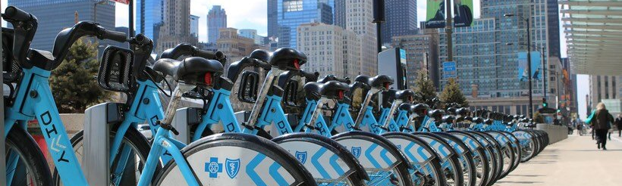
Business Task
Understand how annual members and casual riders differ in the way they use Cyclistic bike hire service.

Slide 3
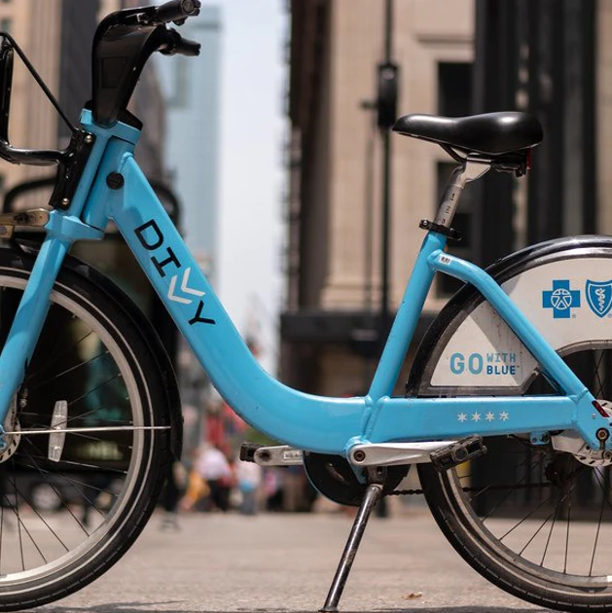
The following slides present charts showing trends and insights we have found analysing the data.
We have used data from August 2020 to August 2021. The sample data used to produce the charts has 99% confidence level and 0.15% margin of error.

Slide 4
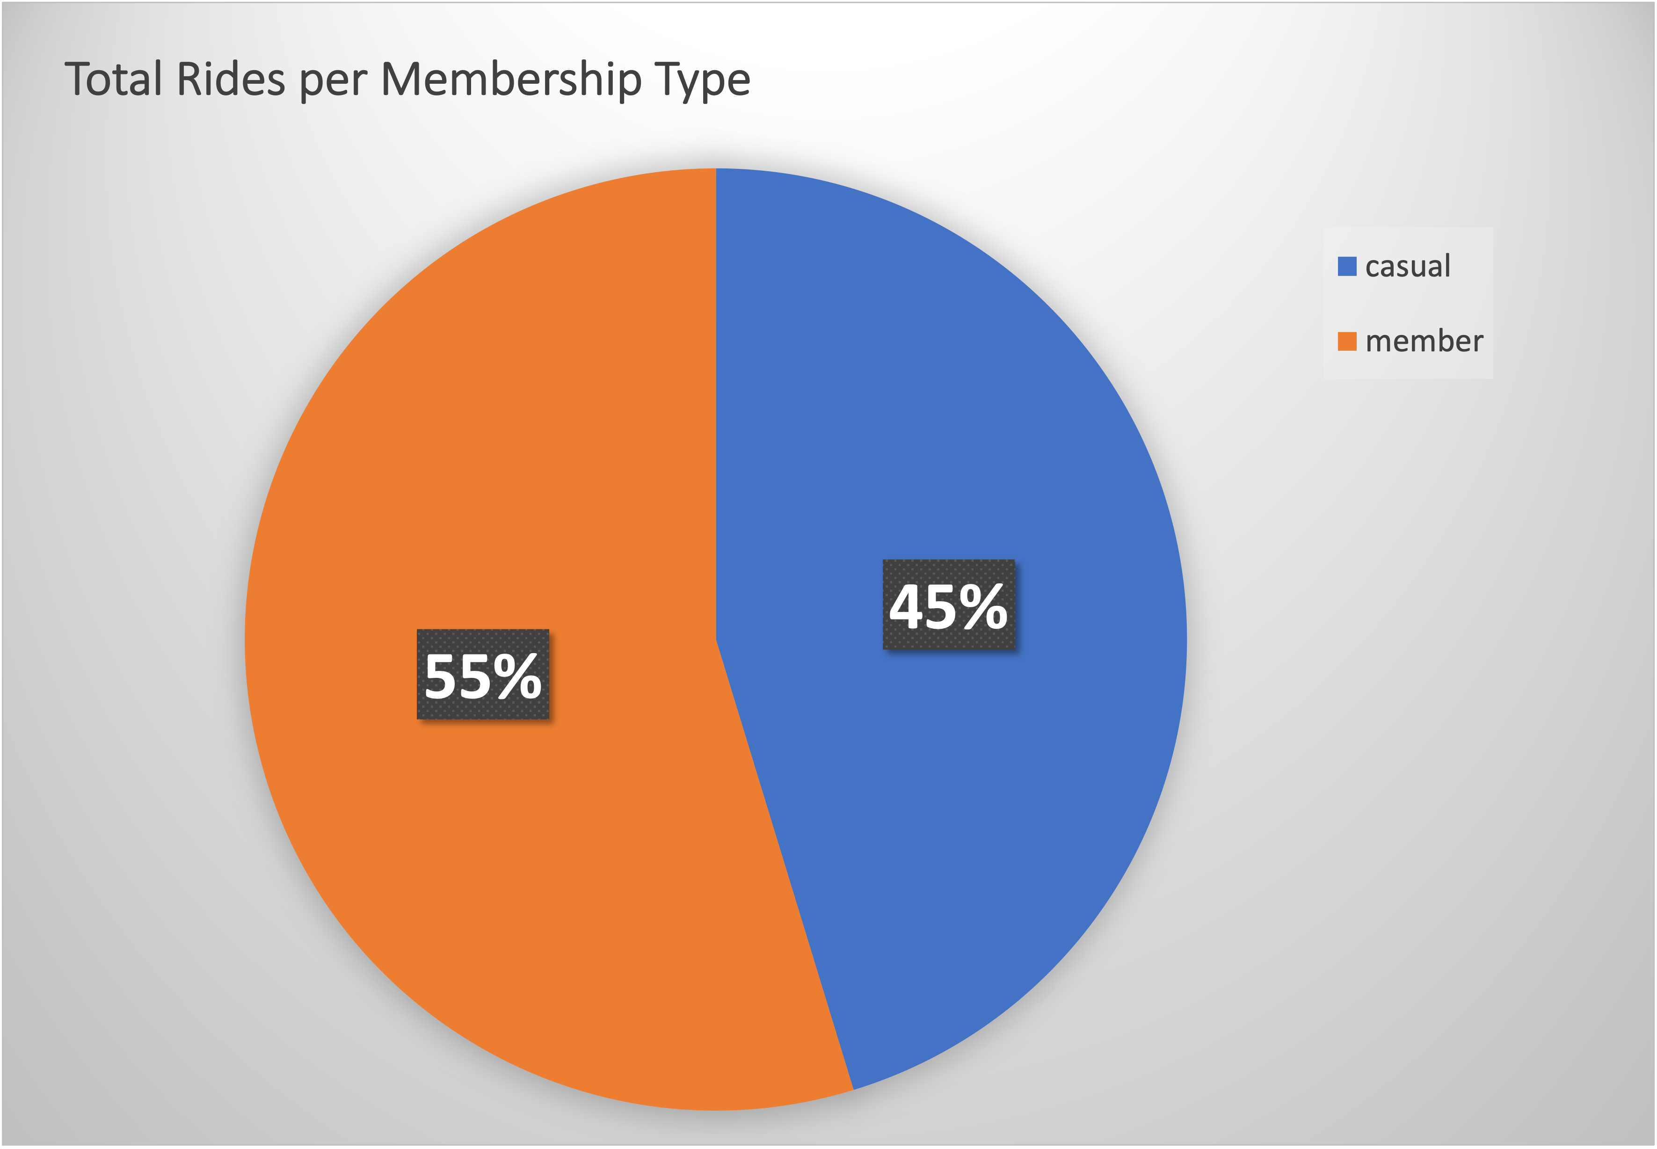
Rides Per Membership Type
Members ride more than casuals.

Slide 5
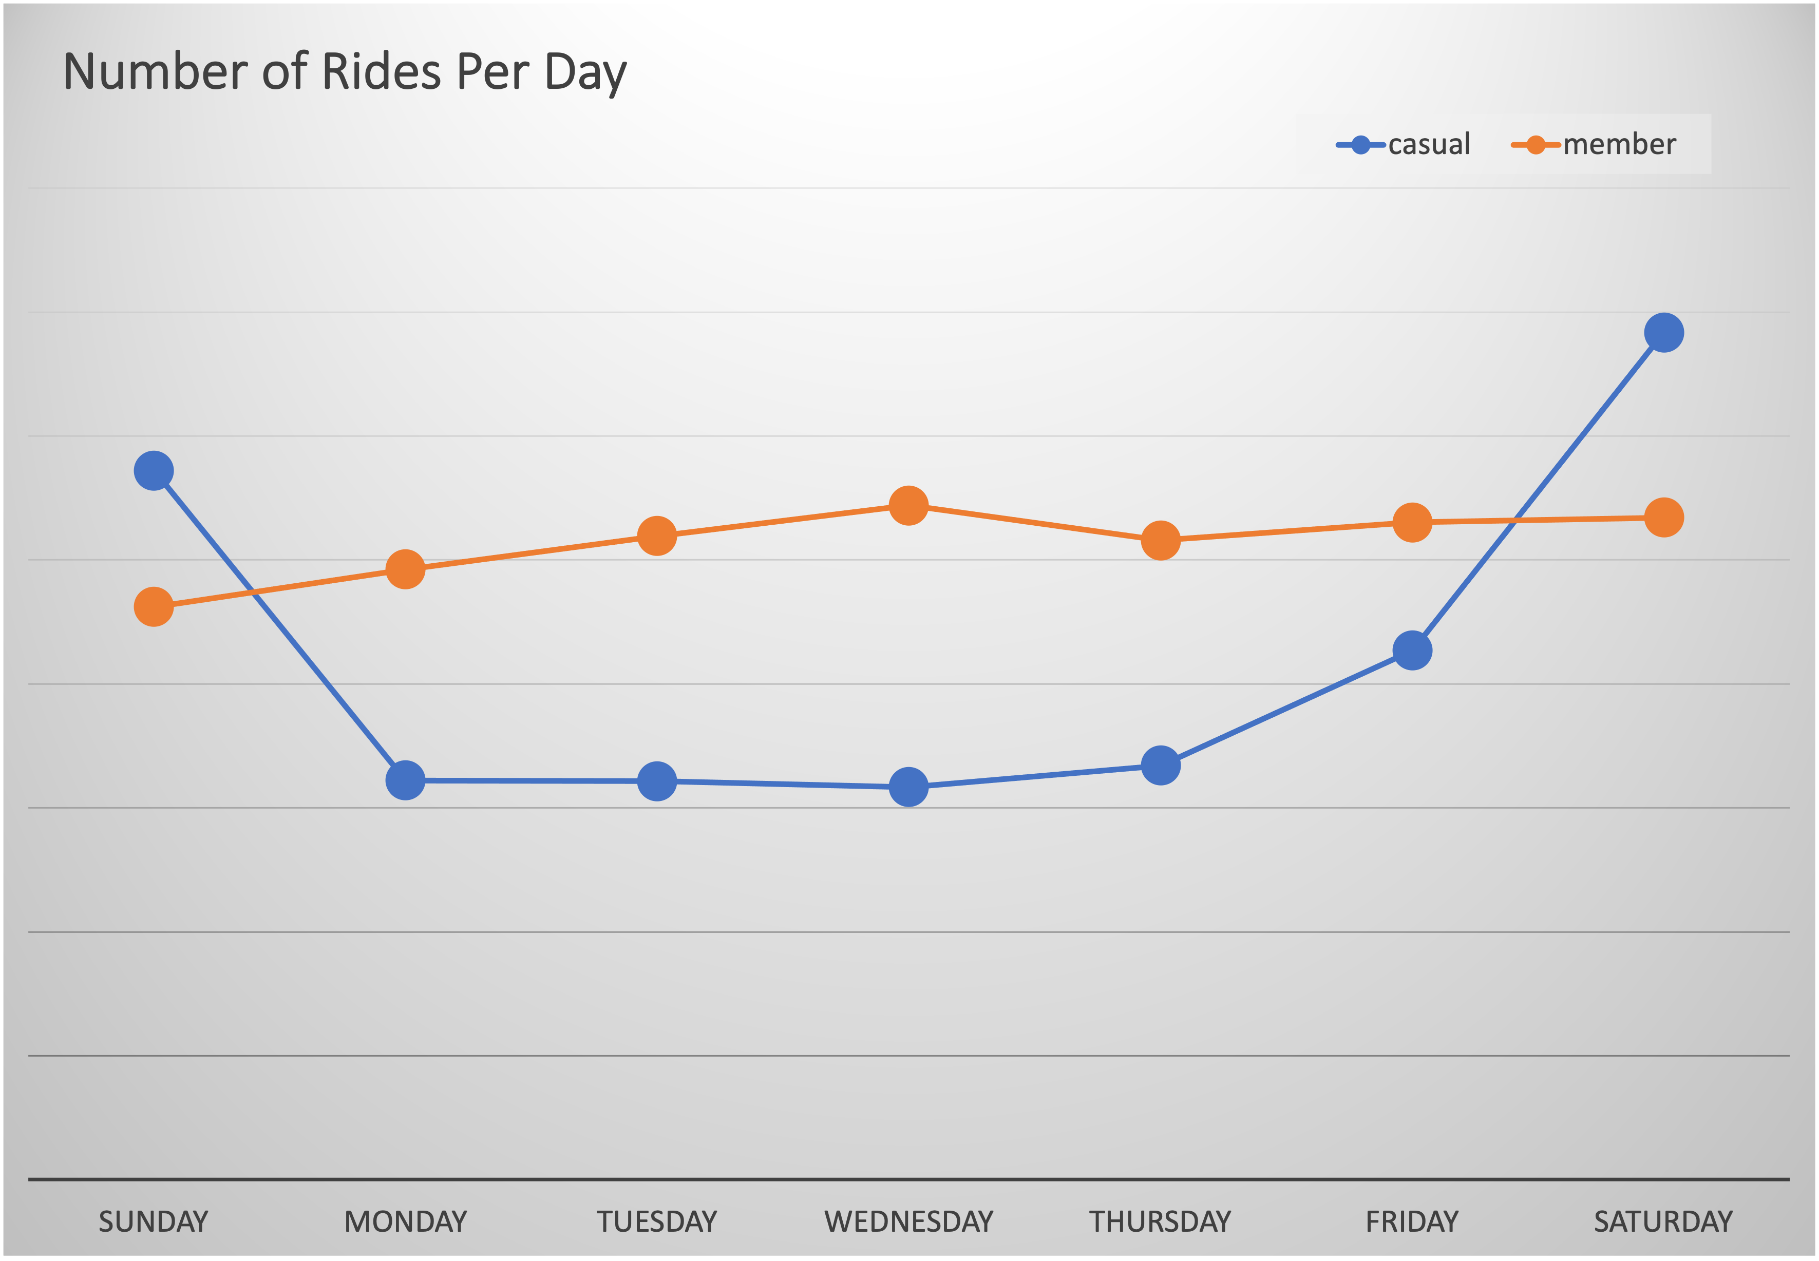
Rides Per Day
The number of rides by casual riders on the weekend is much higher than on the rest of the week.
Members tend to use the service evenly during the week with a slight decrease on Sunday.

Slide 6
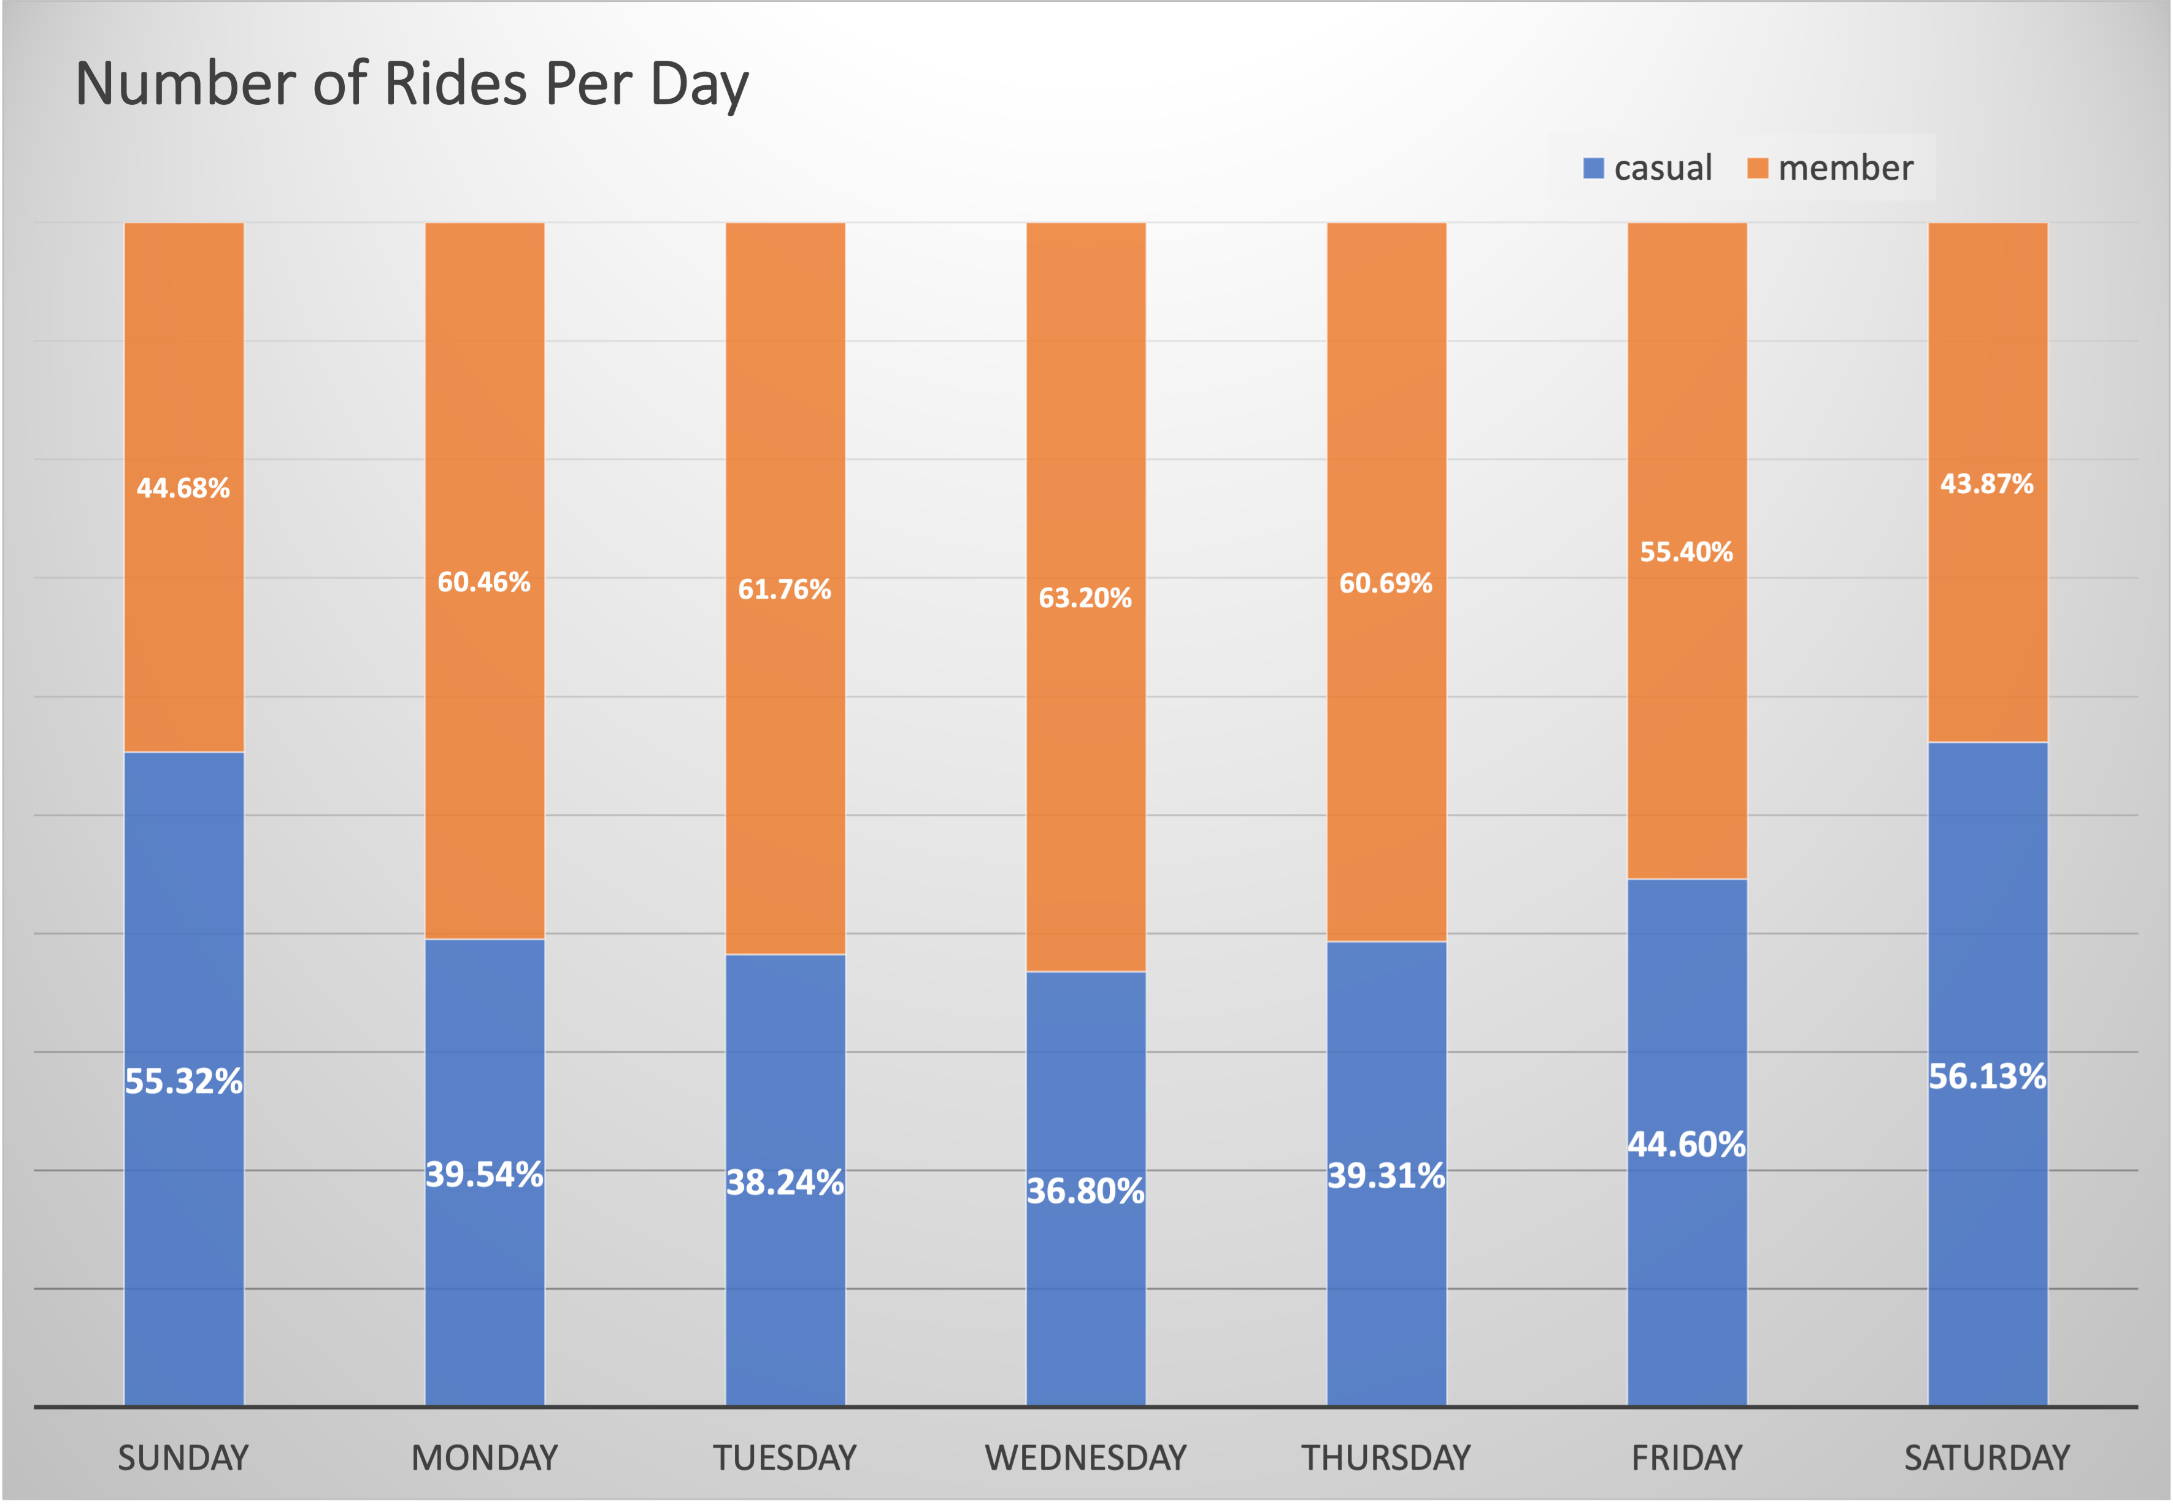
Rides Per Day
The number of rides done by members is higher than by casuals during the most of the week except on the weekends.

Slide 7
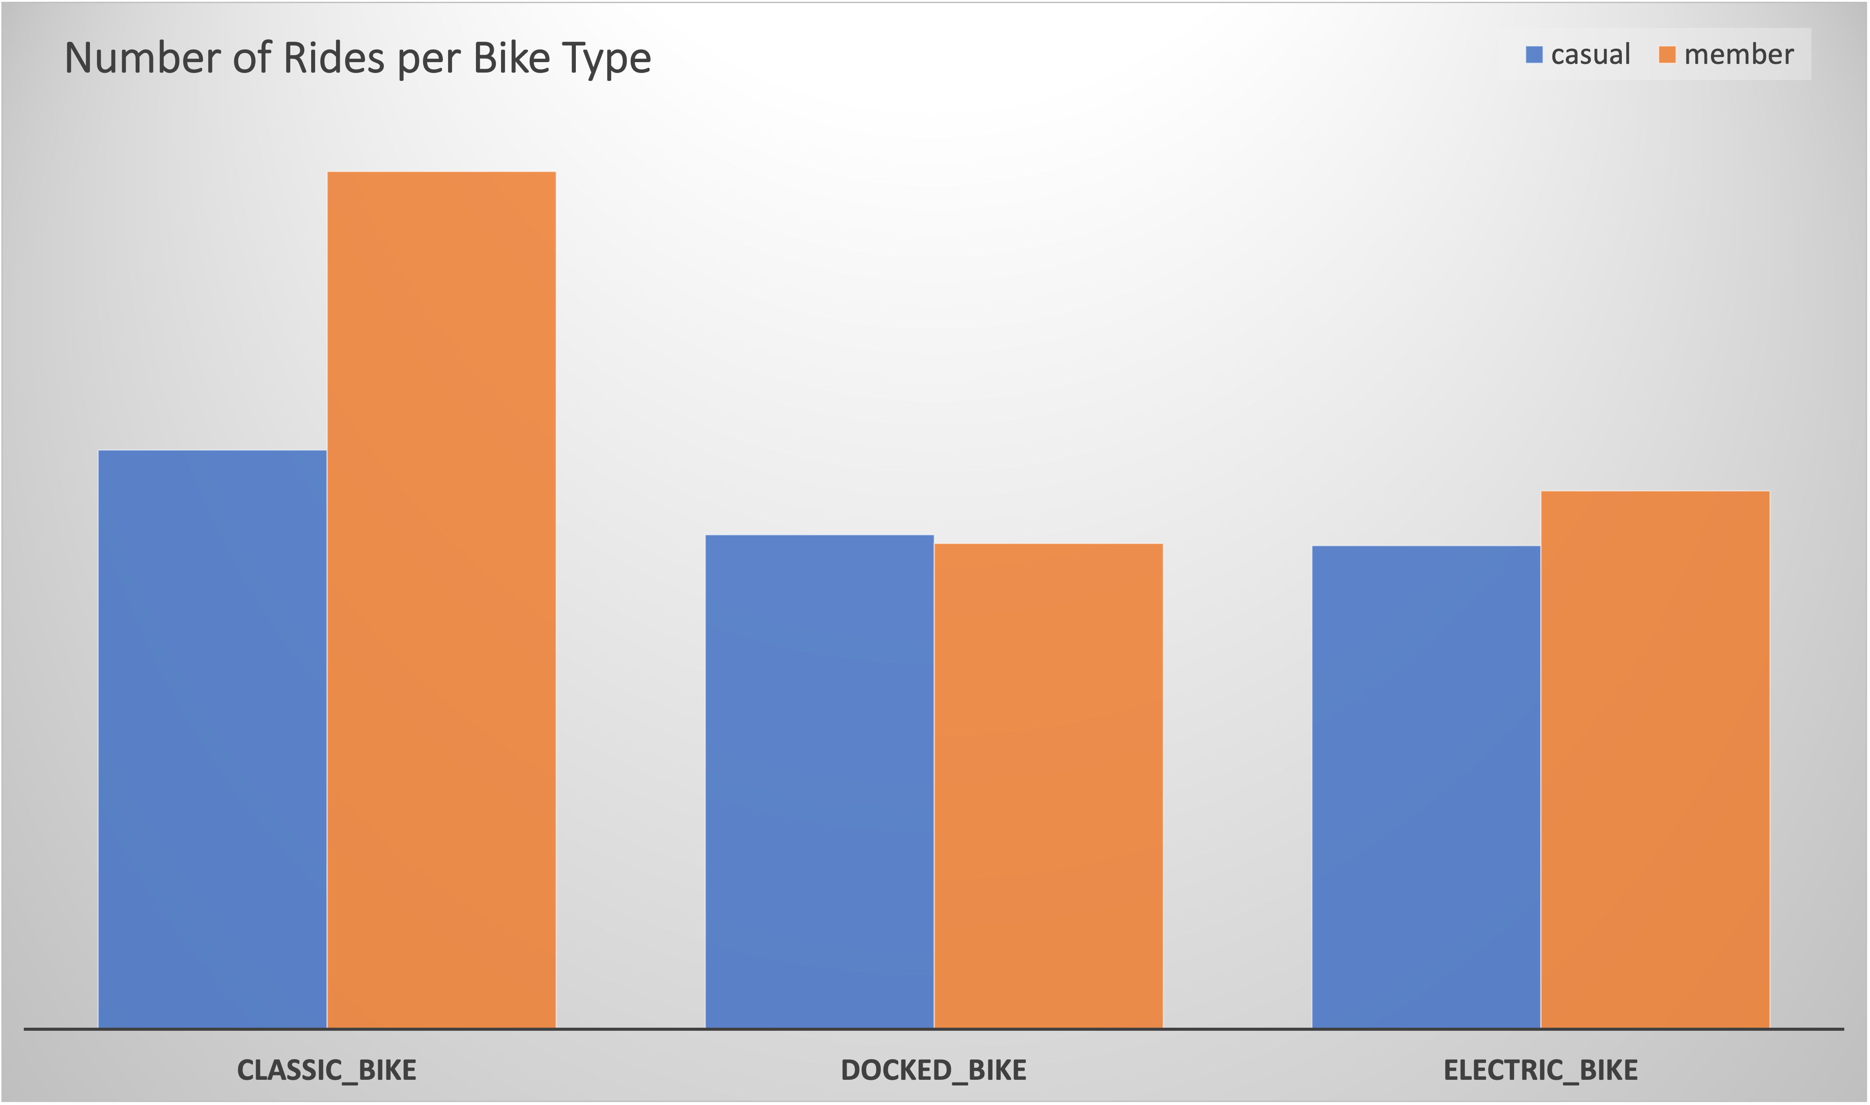
Rides Per Bike Type
The classic bike type is the one preferred among riders.

Slide 8
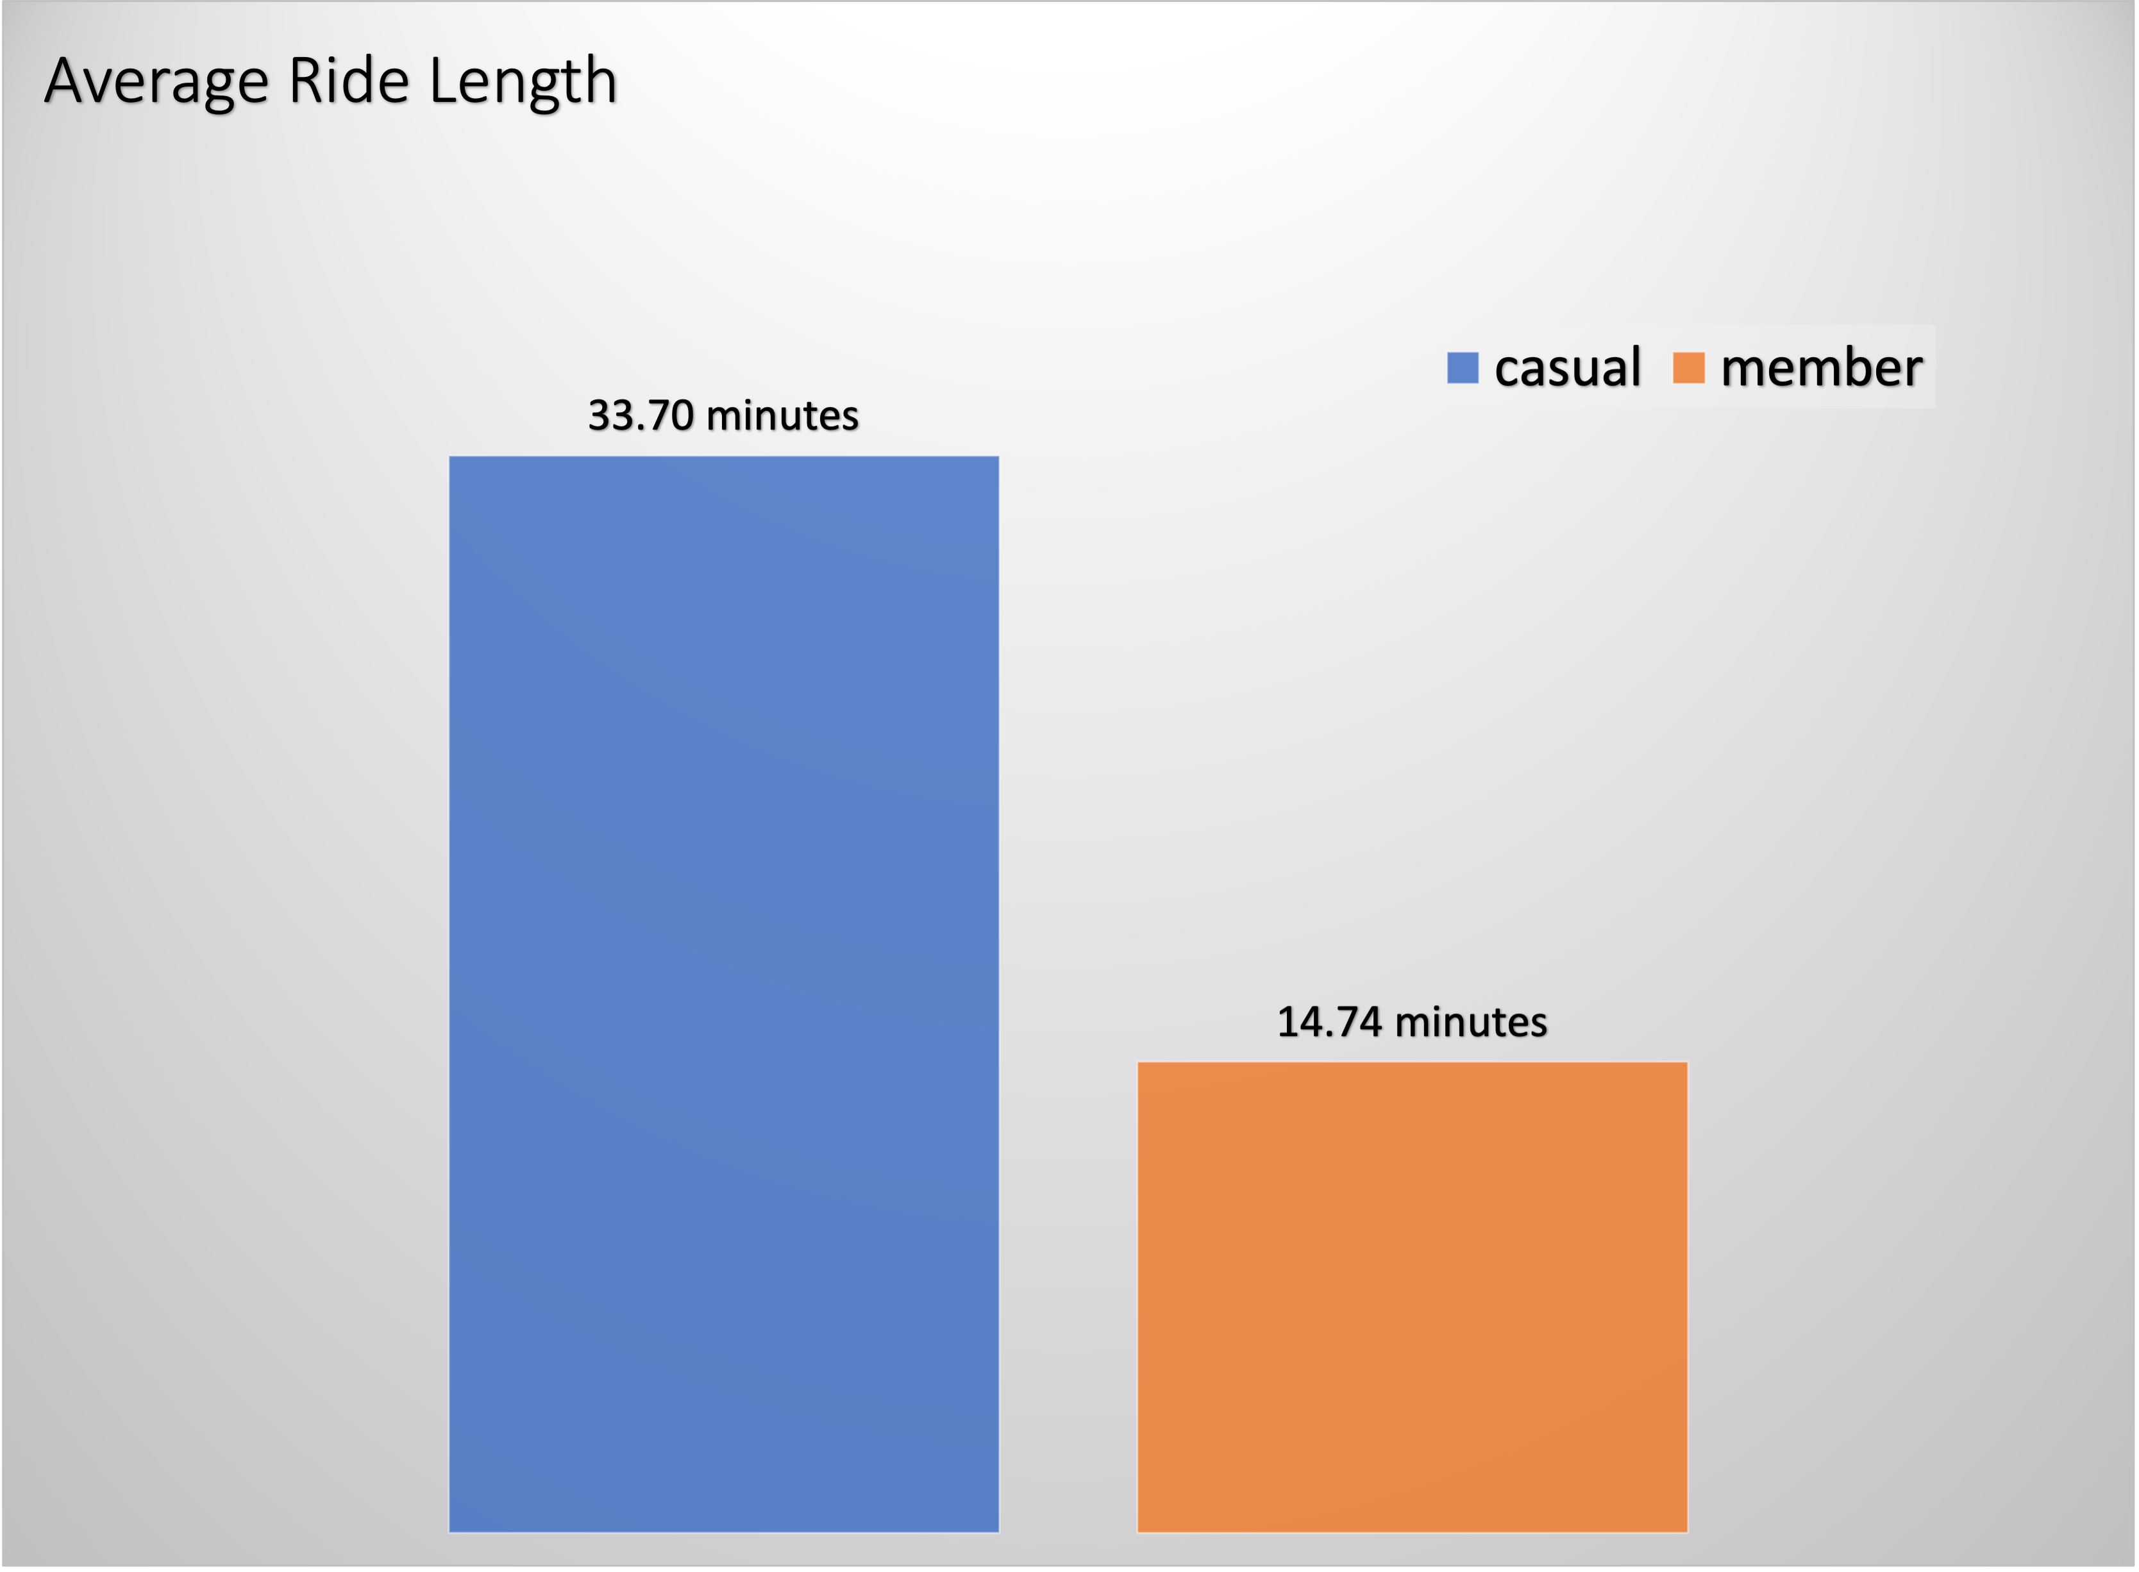
Average Ride Length
Casual riders average ride length is 2.3 times greater than member’s.

Slide 9
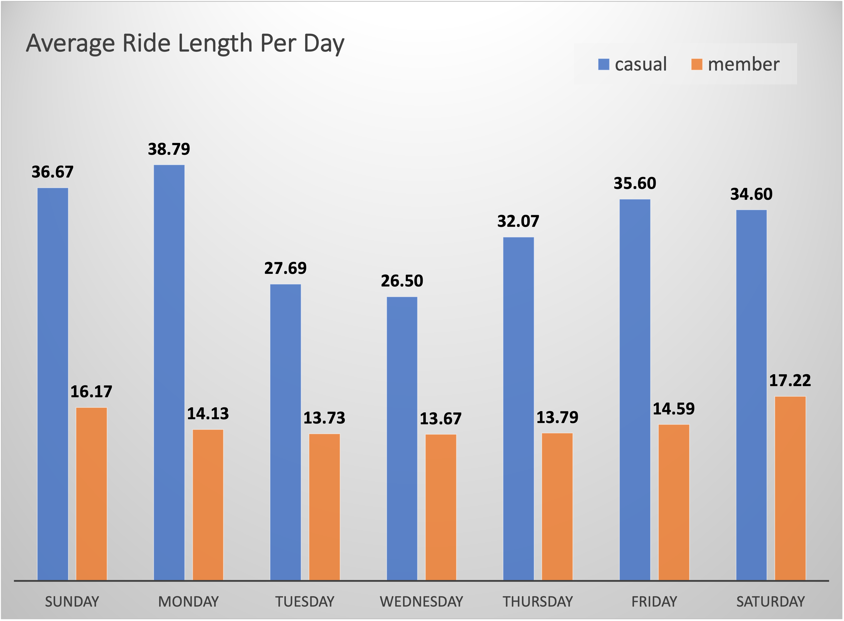
Average Ride Length Split by Days
The average ride length of casual riders is much higher than member’s. Also, it fluctuates much more while member’s doesn’t change much, especially from Monday to Friday.

Slide 10
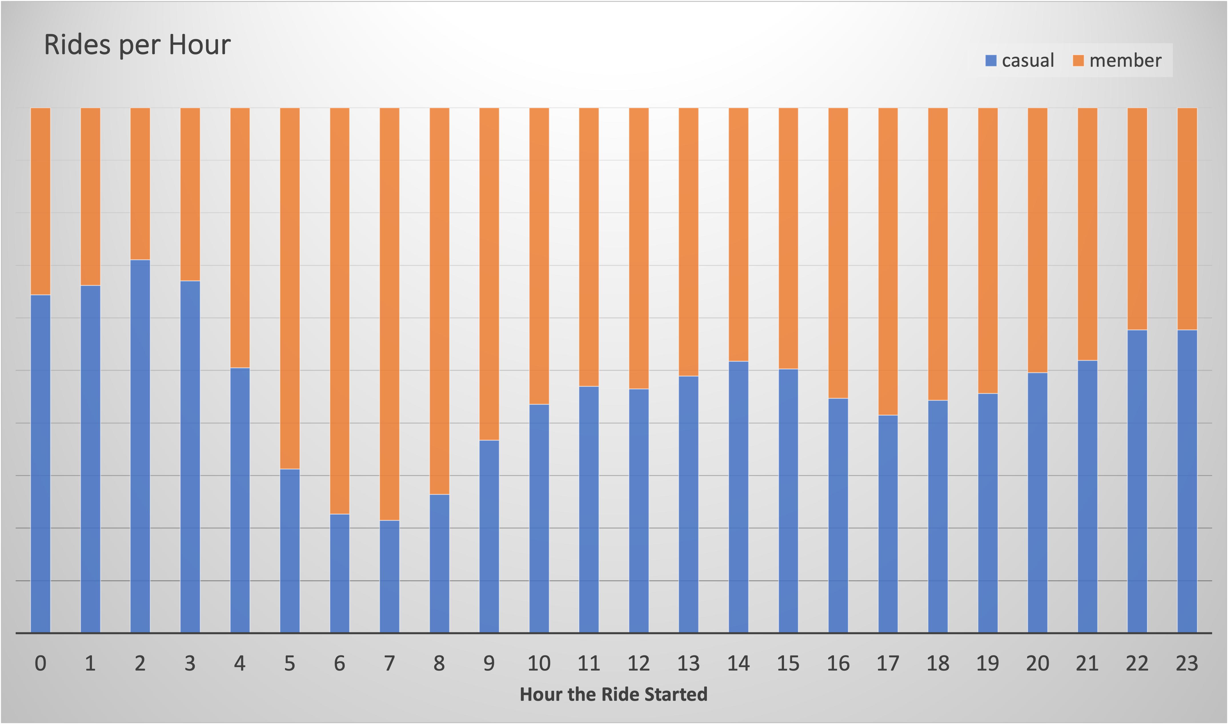
Number of Rides per Hour
Number of rides of members is higher in the morning from 5am to 10am and from 4pm to 7pm. This is probably due the fact members might be using the bike to commute.

Slide 11
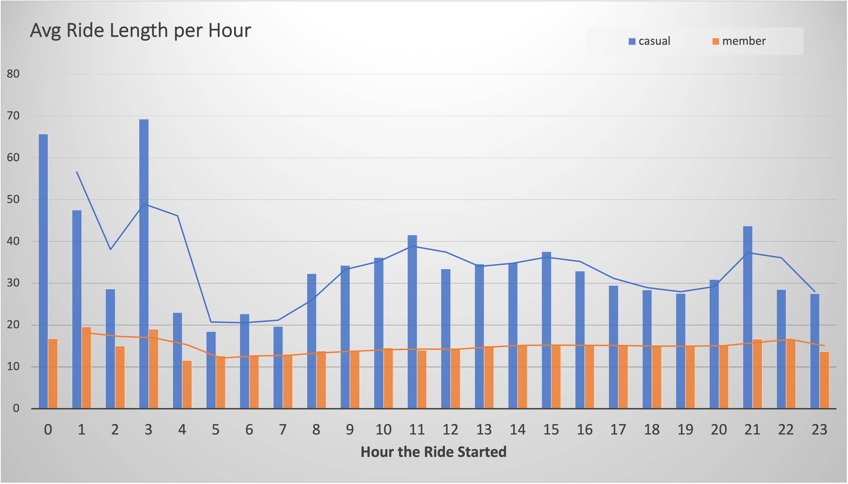
Average Ride Length per Hour
The average ride length of members does not change much during the day. The curve representing the fluctuation is almost flat.

Slide 12
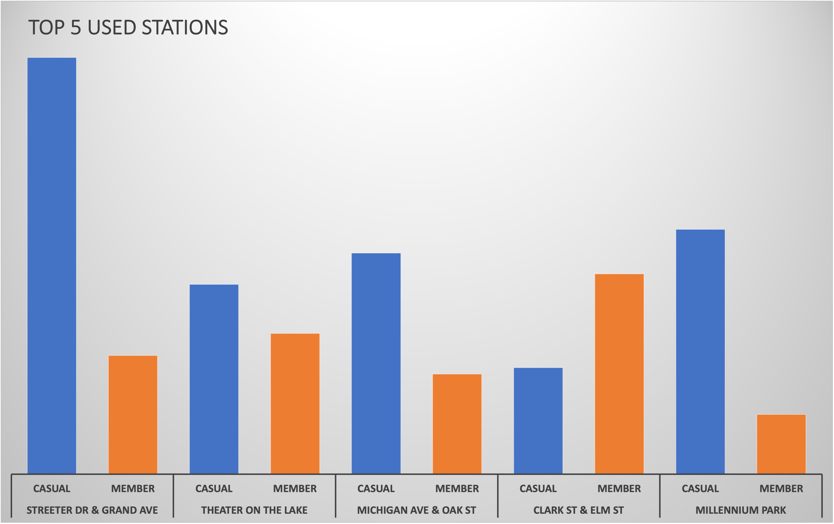
Average Ride Length per Hour
The 5 most used stations that are located near touristic hotspots are mostly used by casual riders.

Slide 13
Key Insights
Members tend to ride more early in the morning and late afternoon.
Members in general ride more but for a shorter period than casual riders.
Casual riders are more active on the weekends.
Member’s average ride length is pretty consistent and does not change much during the day. Casual riders average ride length changes a lot and does not show a pattern.

Slide 14
Summary
Casual riders use the bike more on the weekend for recreational purposes. Weekend usage for casual riders grow both in number of rides and average ride length.
Members use the service to commute to work, school or any other routine activity. The high usage early in the morning and late afternoon could be representing that.
The average ride length does not have correlation with number of rides. In spite of higher number of rides in total, member’s average ride length is considerably lower.
Classic bikes are the most used ones, specially by members.
The most used stations are mostly used by casual riders.

Slide 15
Recommendations
As casual riders tend to ride much more, a way to encourage them to migrate to annual membership would be changing the way Cyclistic charges the client to a ride length charge system instead of single-ride of daily passes.
Casual members ride more (length and number of rides) on the weekend so we should focus the marketing campaign (offering discounts and hosting events) to attract to annual memberships on the weekends.
Advertising on the most used stations and the ones near touristic places could be a good strategy to attract casual riders since they are the majority in number of rides on those stations.

Slide 16
THANK YOU
AND
RIDE SAFE.
Eduardo Rodrigues
eduardodmr@ymail.com

